Slide 1

Stronger
An App to Motivate and Entertain
By roee Zalicha, Saar ofek and michal mano

Slide 2
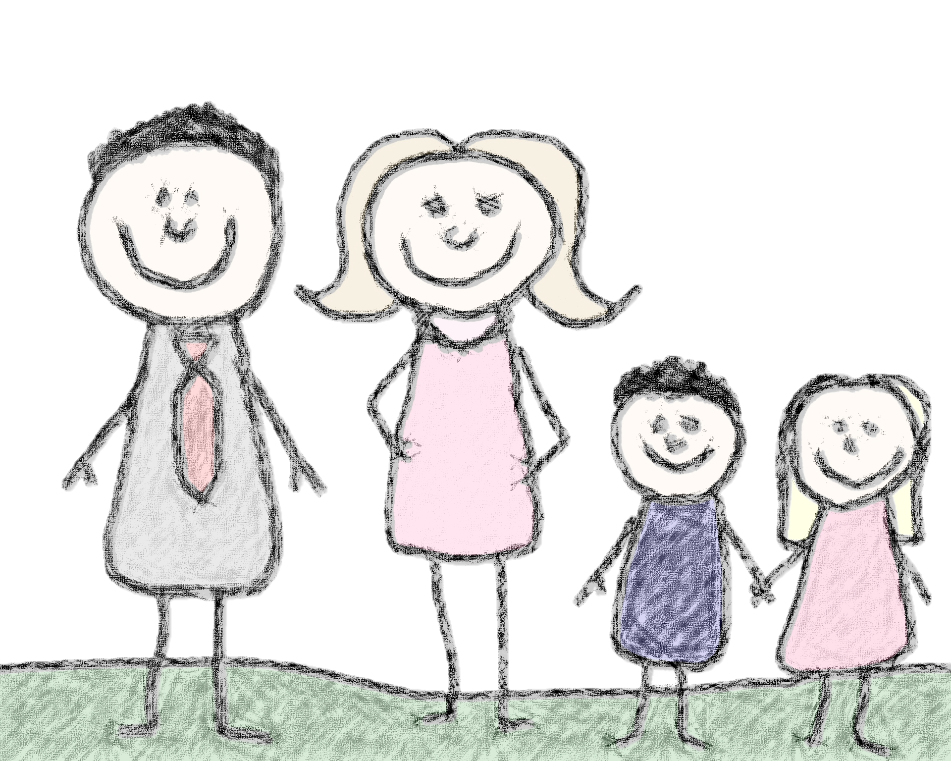
Our Motivation
The path of treatment is long and scary – many trips to the hospital, long treatments that can be boring or painful, and the fear of the unknown.
Children can be stuck waiting in the car, waiting for the doctor, waiting for a treatment to end, and waiting for discharge from the hospital.
We want to help children deal with these challenges alongside their parents.

Slide 3
Our Solution
Stronger is an app that gameifies the treatment experience in order to reward children and motivate them on the path to health.
For each treatment completed, the child is rewarded with Strength (points) that can be used to buy rewards and upgrade in-app games.
Checking off tasks and watching the timer count down helps motivate the child to continue being patient, and earning Strength gives them a feeling of reward.
Child with himself – we chose not to make it a multi-player experience

Slide 4
Flow
Setup
Synch their accounts with a shared ID
Adding Treatments
Stock the Shop
Start the Timer
Parent and Child Download the App
Parent adds treatments that the child will undergo, which show up in the tab
Parent adds prizes to the shop, like candy and games
When the child leaves home to start their treatment, they start the clock
Gain Points
Every time a treatment is completed the child is rewarded with Strength for use in the store
The doctor is late? Overtime means more rewards!
The shop contains upgrades for in-app minigames
The nurses can give the child a QR code that they scan for extra Strength if they were extra brave

Slide 5
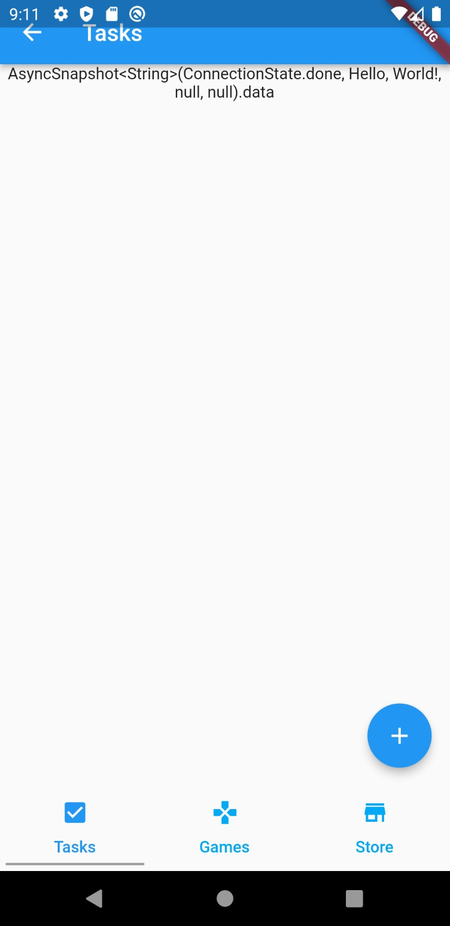
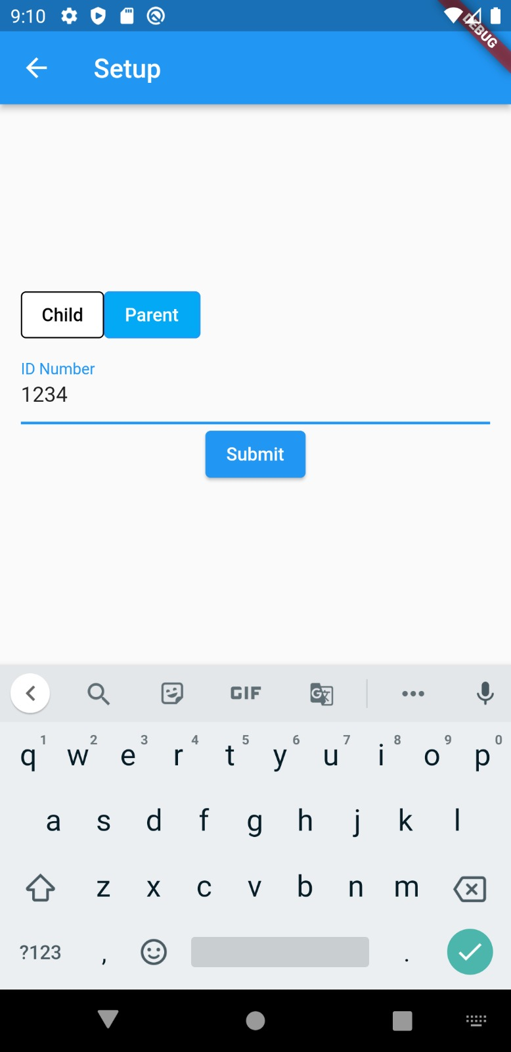
Main Features Parent vs. Child
Dialysis
04:00
Start
Unique family ID is saved in a database (FireBase)
From setup, only parents have the ability to add to the treatment and store tabs

Slide 6
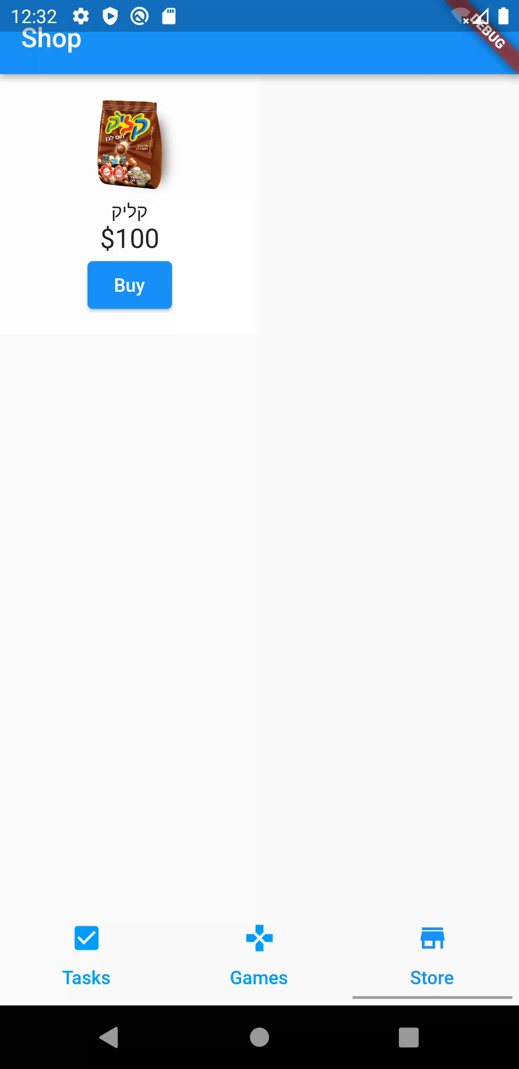
Main Features Rewarding experience
As the child goes through an often boring or painful treatment, they earn more and more points that the can use on rewards.
They can unlock new minigames, earn upgrades in existing games, and buy prizes from their parents!

Slide 7
Main Features Treatment Timer
Dialysis
04:00
When the child starts the treatment, a timer starts counts down…
If the timer goes into overtime (because of waiting times) the child can earn more points, which puts a silver lining on an otherwise frustrating experience
Start
Dialysis
+00:12
Finish

Slide 8
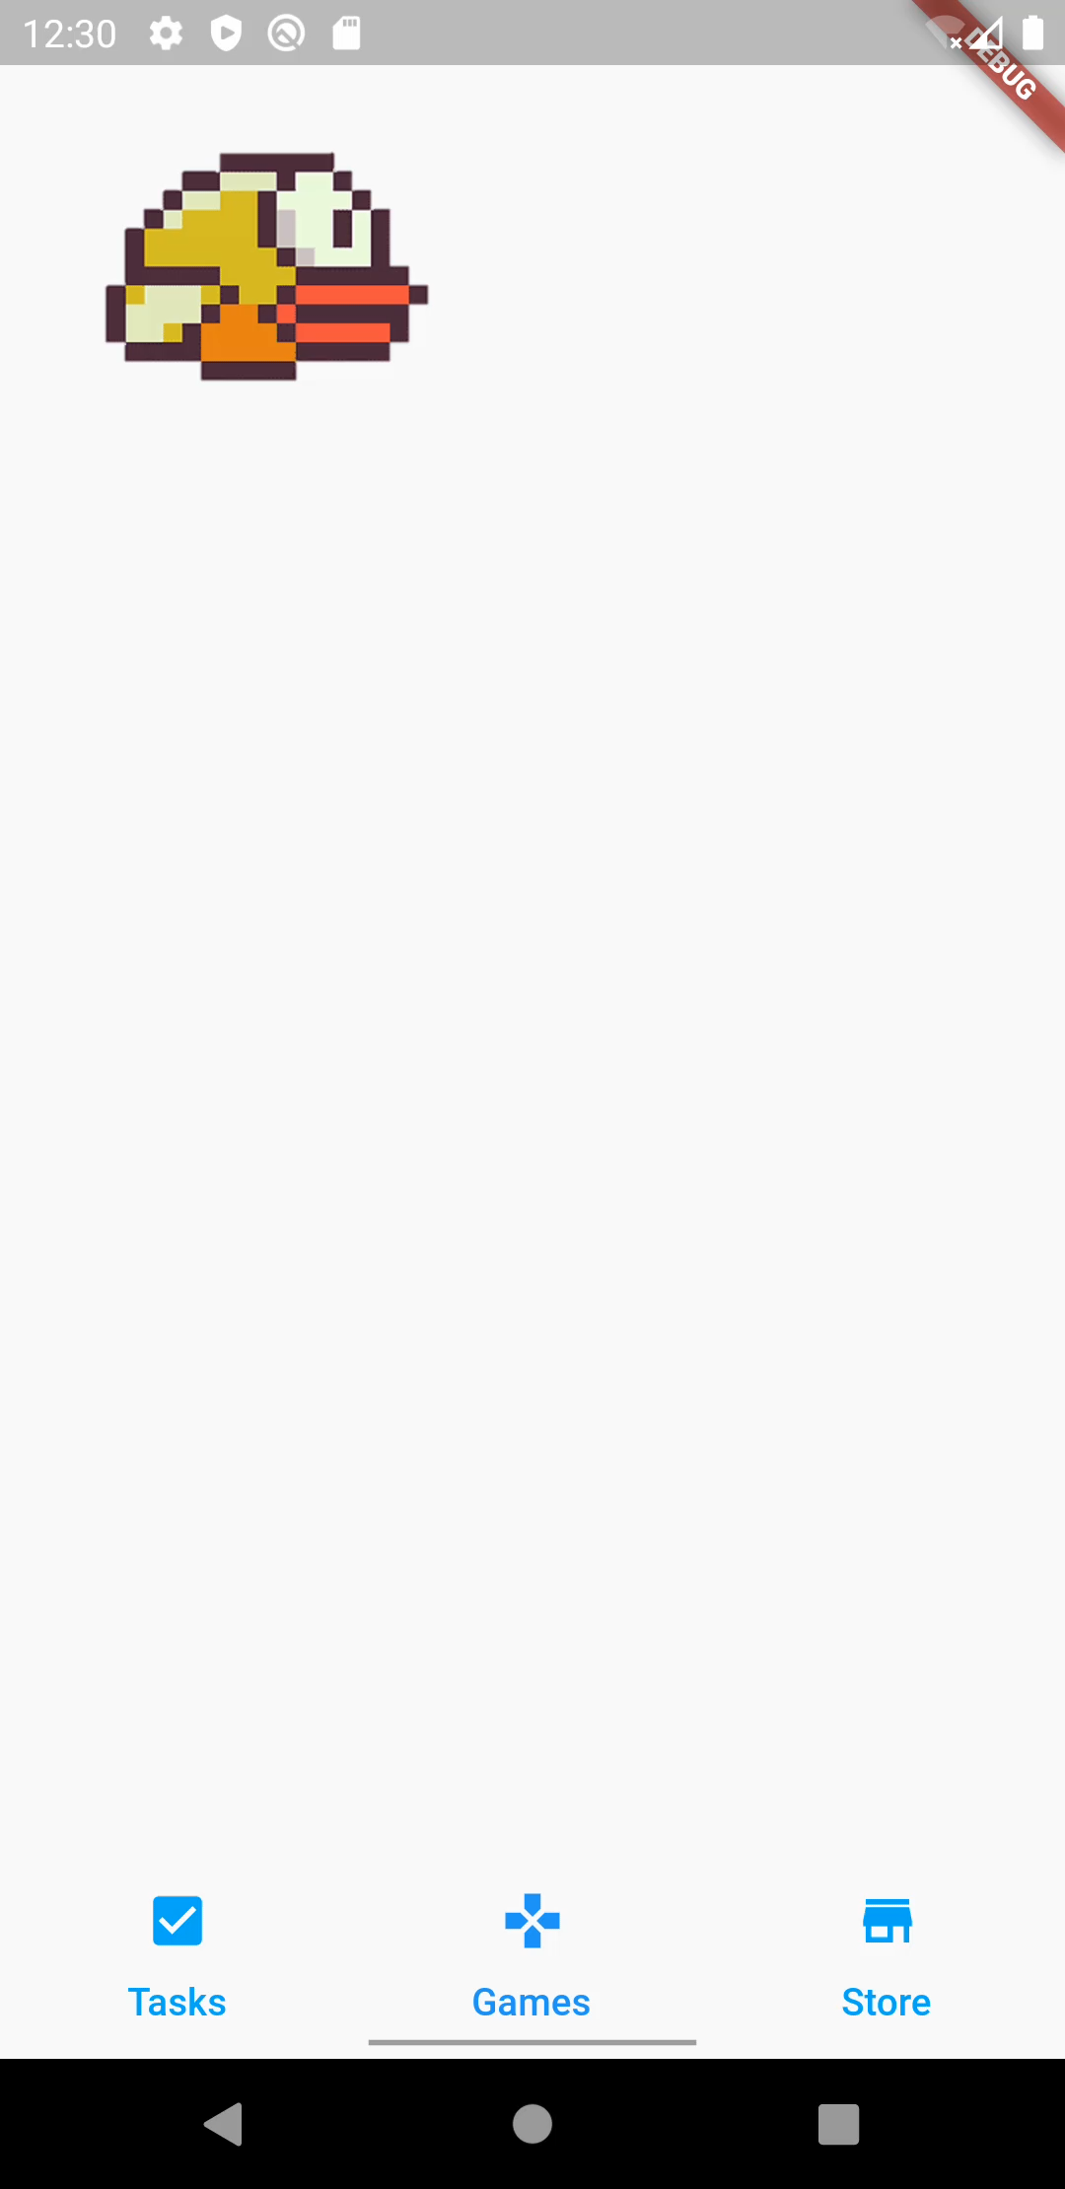
Main Features In-app minigames
While the child is waiting, they can play minigames
Using points, the child can upgrade the minigames and unlock new ones

Slide 9
Conclusion
Stronger gives the child motivation to go through with their treatments by rewarding them for every difficult and boring task they must complete on their journey to health.
It can help pass the time and help the child handle boredom and frustration.
The app also allows the parent to keep their child in the loop on the next treatments they’re going to go through.

